Slide 1

DaTAXI Science
A Data Science approach to analyze and predict Medallion Taxi Demand
Jishu Basak

Slide 2
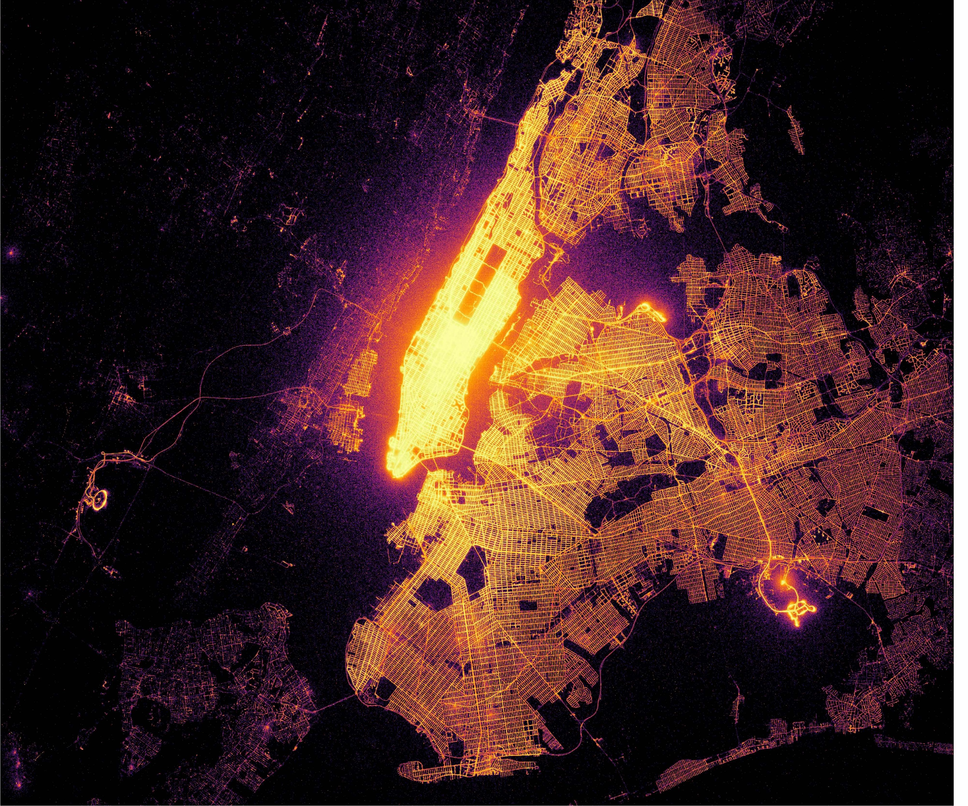



~200M Taxi Rides
~170K Taxi
Professionals
~$ 1.8B Gross
Income
Based on 2017 NYC Yellow Trip Data

Slide 3






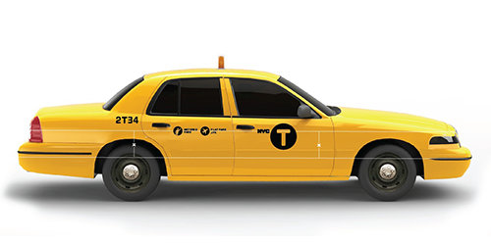



5 Boroughs
<5 Boroughs
1971
2013
13587
7676
Medallion Taxi Cabs
Boro Taxi Cabs

Slide 4
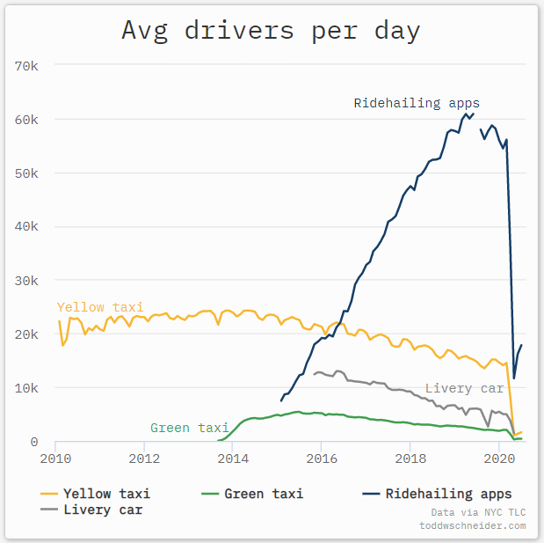
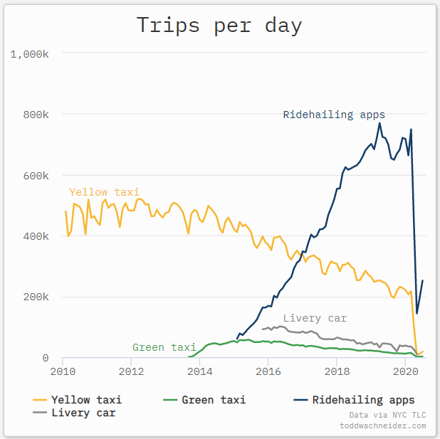
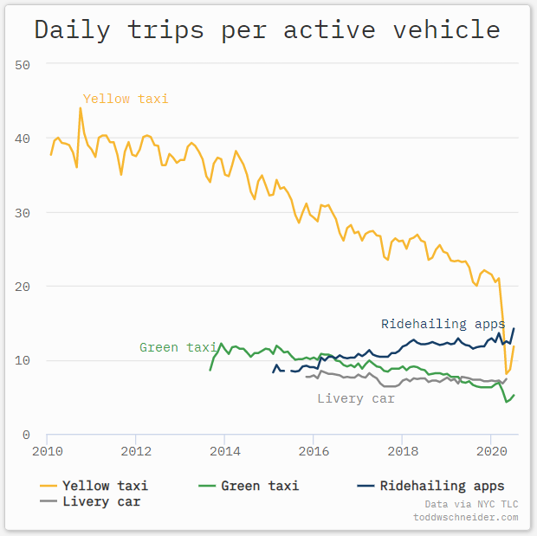

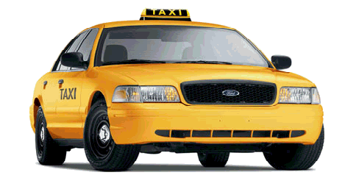

Declination of:
Medallion Taxi Demand
Medallion Taxi Drivers
Yellow Cabs

Slide 5



TAXI
PROBLEM
STATEMENT
How can Data Science address the pitfall in demand of Medallion Taxi in NYC?

Slide 6






In Scrutiny: Demand
Yellow Cabs Demand Analysis and Prediction
In pipeline
Data Extraction
Data Analysis
Feature Engineering
Modelling

Slide 7




Data Extraction
Data Analysis
Feature Engineering
Modelling
Original Data Source
Type | Information
Dataset | Yellow Taxi Trip
Year | 2017
No. of Datapoints(rows) | 113M
No. of Features(columns) | 17
BigQuery API
+
SQLAlchemy
Warehouse for Extraction

Slide 8
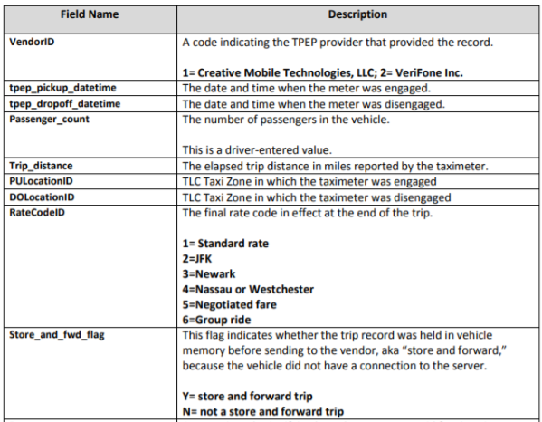
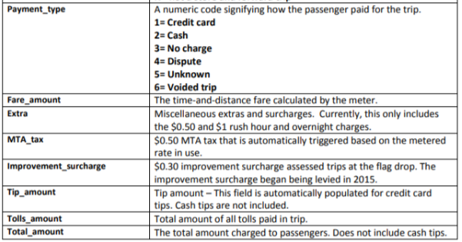
Data Extraction
Data Analysis
Feature Engineering
Modelling
Data Description

Slide 9

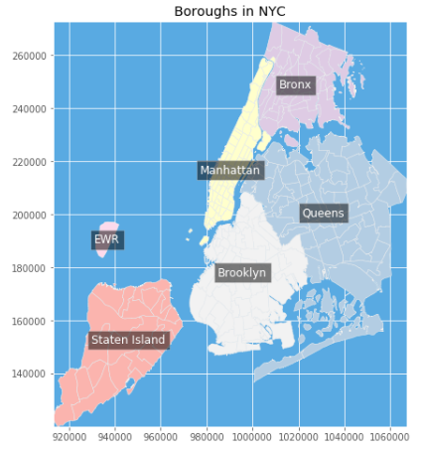
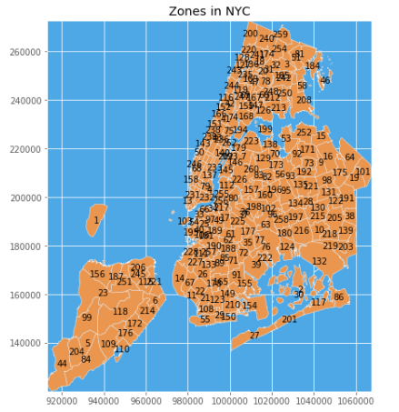
Data Extraction
Data Analysis
Feature Engineering
Modelling
Medallion Taxis operates in 5 Boroughs of New York City which are Manhattan, Bronx, Queens, Brooklyn And Staten Island. This is constituted by 255 Taxi Zones

Slide 10
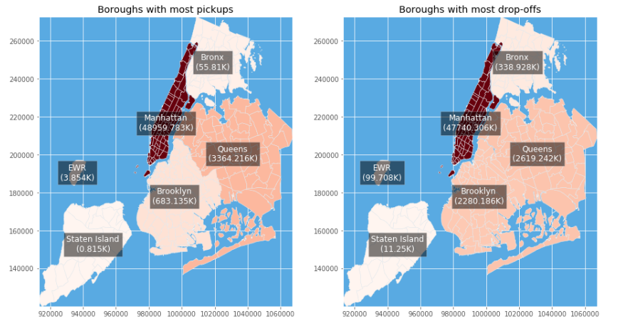
Data Extraction
Data Analysis
Feature Engineering
Modelling
Insight 1: Taxi Demand based on Borough and Zone: Pick Up vs Drop Off

Slide 11
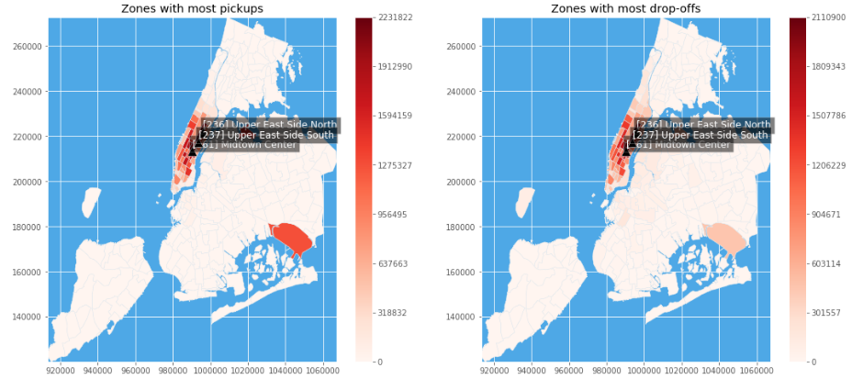
Data Extraction
Data Analysis
Feature Engineering
Modelling
Insight 1: Taxi Demand based on Borough and Zone: Pick Up vs Drop Off

Slide 12
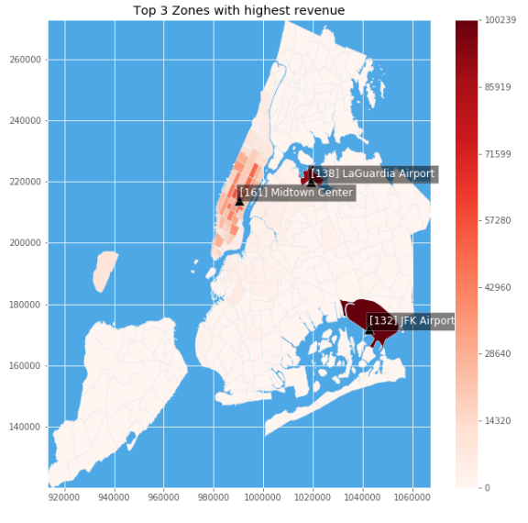
Data Extraction
Data Analysis
Feature Engineering
Modelling
Insight 1: Taxi Demand based on Borough and Zone: Pick Up vs Drop Off

Slide 13
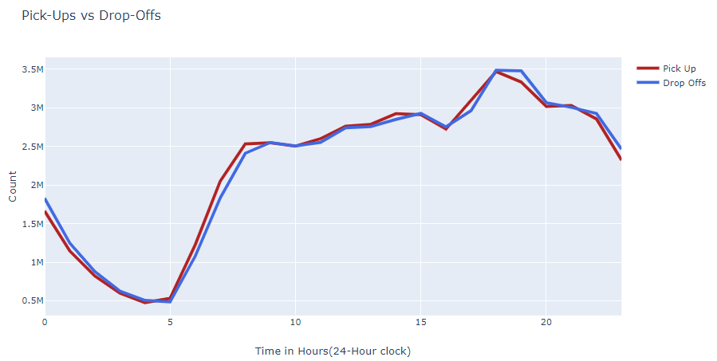
Data Extraction
Data Analysis
Feature Engineering
Modelling
Insight 2: Taxi Demand based on Time: Pick Up vs Drop Off

Slide 14
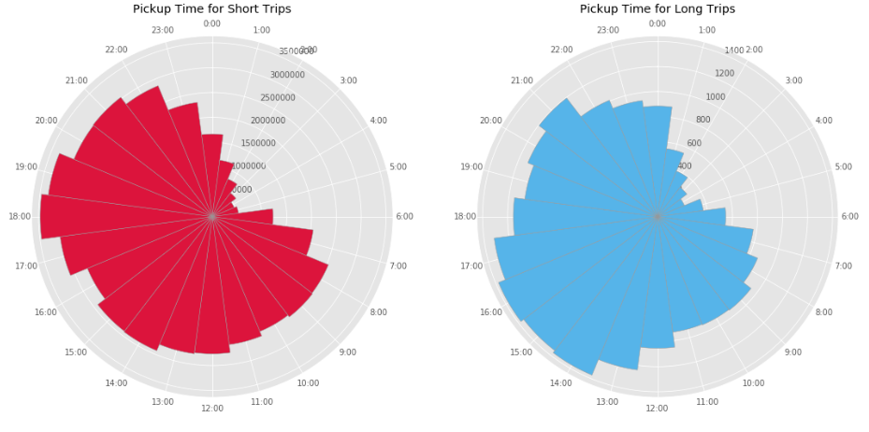
Data Extraction
Data Analysis
Feature Engineering
Modelling
Insight 3: Taxi Demand based on Distance: Short vs Long Distance Trips
Trips longer than 30 miles are considered Long Trip else it’s a short trip

Slide 15
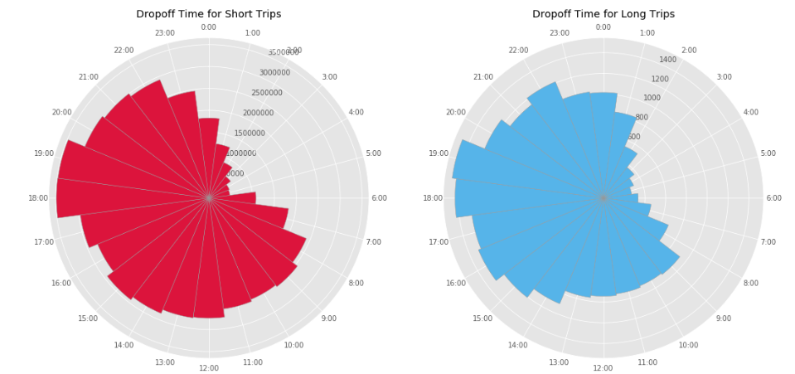
Data Extraction
Data Analysis
Feature Engineering
Modelling
Insight 3: Taxi Demand based on Distance: Short vs Long Distance Trips

Slide 16
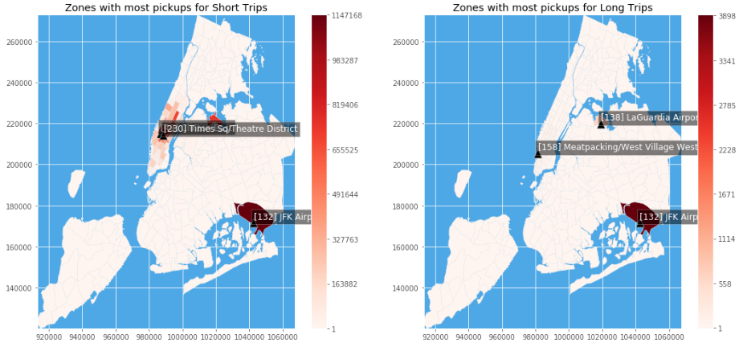
Data Extraction
Data Analysis
Feature Engineering
Modelling
Insight 3: Taxi Demand based on Distance: Short vs Long Distance Trips

Slide 17
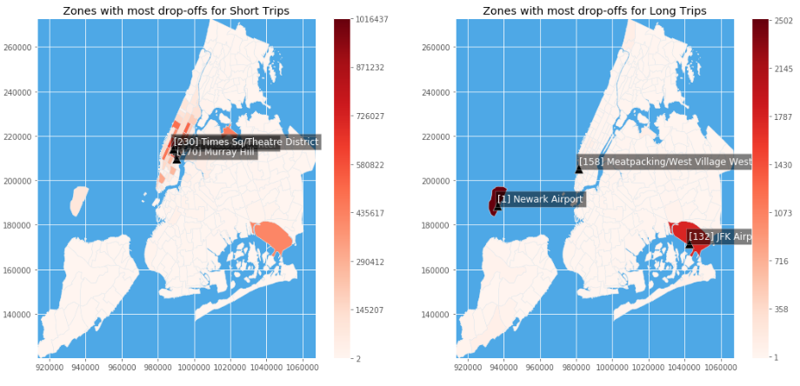
Data Extraction
Data Analysis
Feature Engineering
Modelling
Insight 3: Taxi Demand based on Distance: Short vs Long Distance Trips

Slide 18




Data Extraction
Data Analysis
Feature Engineering
Modelling
Feature Extraction
Feature Grouping
Feature Conversion
Month, Day, Hour, Pickup Location, Passenger Count, Total Amount
Grouping Total Amount and Passenger Count by Month, Day, Hour and Pickup location with Sum as aggregator
String Indexing, One Hot Encoding and Vector Assembly

Slide 19






Data Extraction
Data Analysis
Feature Engineering
Modelling
Predicting Passenger Demand
Predicting Gross Revenue Demand

Slide 20

Data Extraction
Data Analysis
Feature Engineering
Modelling
Model Architecture - Overview
Data Set
Pre-processing
Feature Engineering
Learning Algorithm
Prediction
Final Model Evaluation
Hyperparameter Optimization

Slide 21

Data Extraction
Data Analysis
Feature Engineering
Modelling
Model Implementation
String Indexer
Linear Regression
Training
Parameters:
Best Model
(RMSE, R² Error)
Decision Tree
1. Train/Test Split- 70:30
Load Preprocessed Data
One Hot Encoding
Hyperparameter Optimization
(Grid Search)
2. Cross Validation- 30%
Gradient Boosting
Vector Assembly
Prediction
Random Forest
Feature Engineering
Model Selection

Slide 22

Data Extraction
Data Analysis
Feature Engineering
Modelling
Model Implementation
Decision Support Tool
Data for
Model 1
Prediction of Passenger Count
String Indexer
Linear Regression
Training
Parameters:
1. Train/Test Split- 70:30
Decision Tree
Best Model
(RMSE, R² Error)
One Hot Encoding
Hyperparameter Optimization
(Grid Search)
Gradient Boosting
2. Cross Validation- 30%
Data for
Model 2
Vector Assembly
Prediction of Gross Revenue
Random Forest
Feature Engineering
Model Selection

Slide 23
Data Extraction
Data Analysis
Feature Engineering
Modelling
Model Results
Model 1: Passenger Demand Prediction

Slide 24
Data Extraction
Data Analysis
Feature Engineering
Modelling
Model Results
Model 2: Gross Revenue Demand Prediction

Slide 25
Data Extraction
Data Analysis
Feature Engineering
Modelling
Model Results
Time Taken

Slide 26





Gradient Boosting outperforms in predicting Taxi Demand
Conclusion and Future Work
Manhattan(Borough), JFK Airport and LaGuardia Airport are the most demanding region and places.
Evenings are the busiest and Mornings, specially around 5AM are silent when it comes to demand.

Slide 27

Neural Network Regression may perform better
K-means Clustering can find hidden patterns, therefore exploiting similar characteristics between different Zones and Boroughs
Conclusion and Future Work
Feature Augmentation such as Weather, Rainfall, Amenities(No. of bars, hotels etc.) data.
Datapoints augmentation with additional historic datapoints for model training

Slide 28
Thank you

